Slide 1
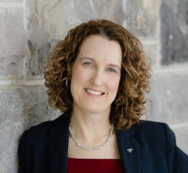
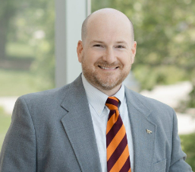
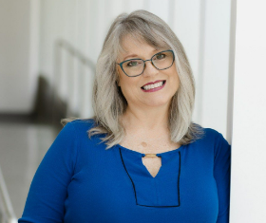
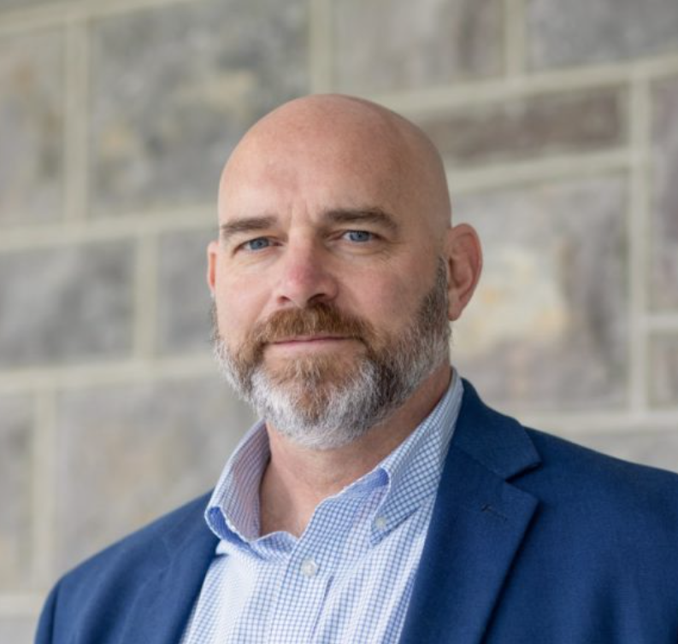
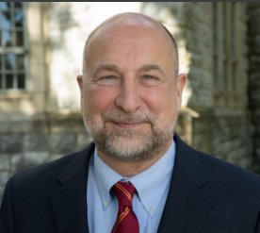
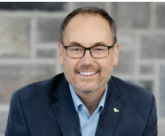
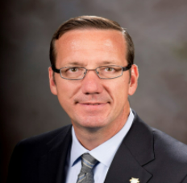
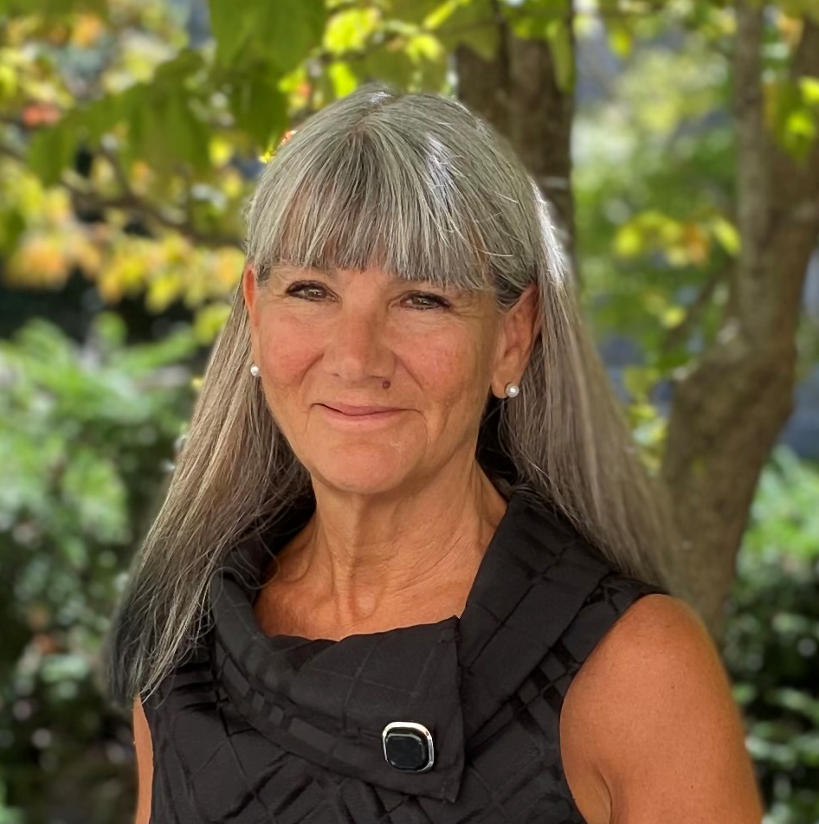
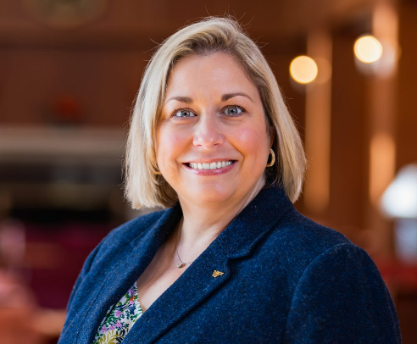
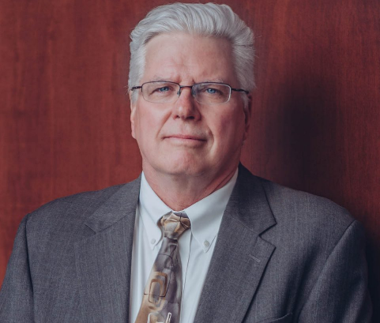
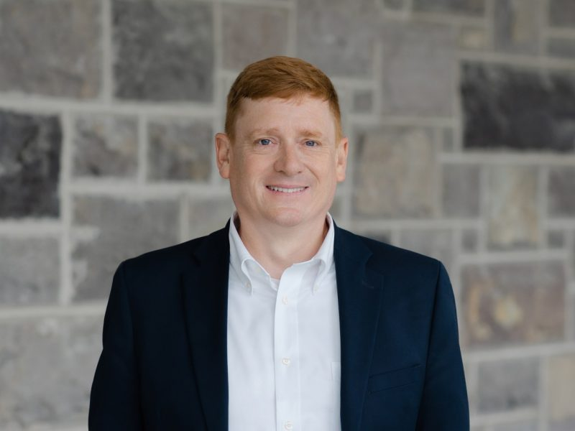
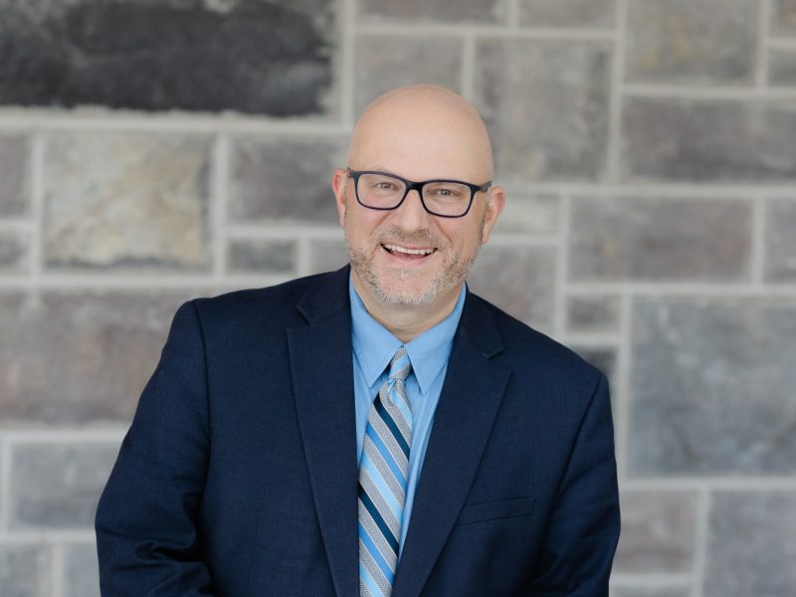
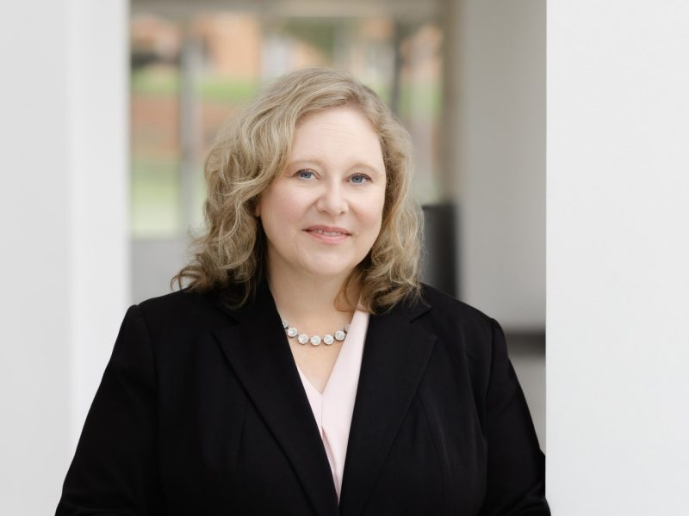
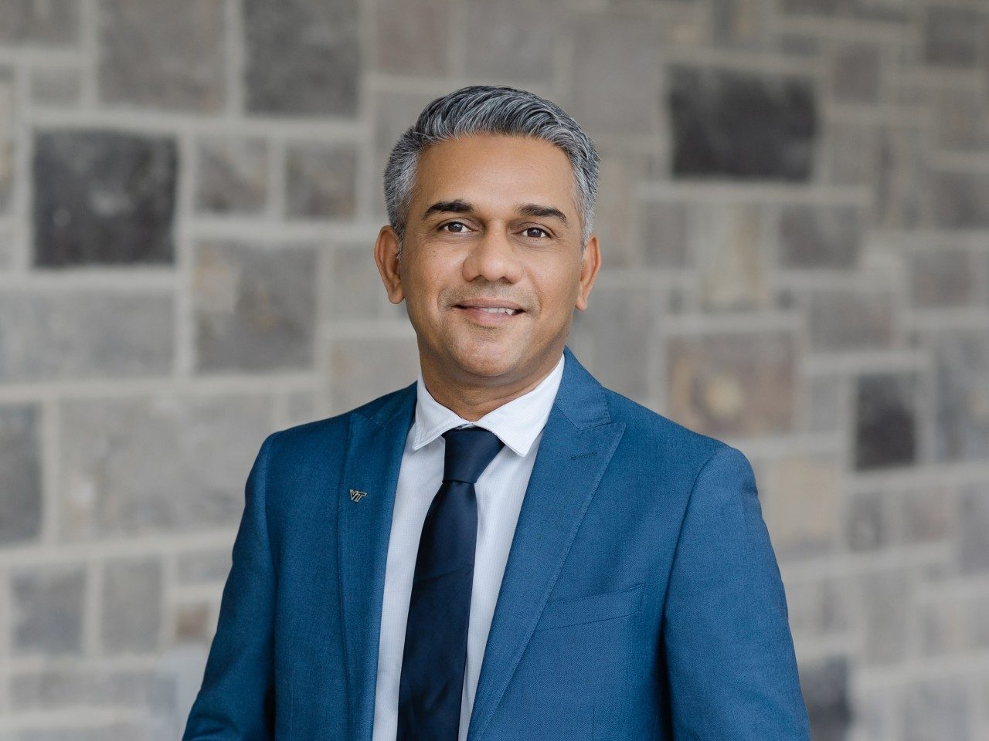
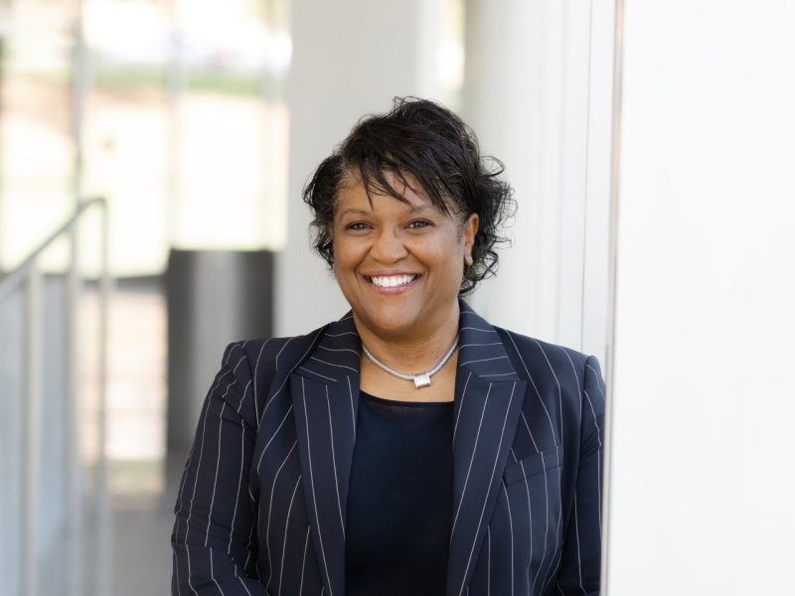
Executive Vice President and Chief Operating Officer (EVPCOO)
Amy S. Sebring
Chief of Staff
Brennan Shepard
Executive Assistant to the EVPCOO
Teresa Wright
University Operations Leadership Team
Vice President for Campus Planning,
Infrastructure,
and Facilities
Bob Broyden
(Interim)
Vice President for Auxiliary &
Business Services
Lynsay Belshe
Vice President for Finance and University Treasurer
Ken Miller
Vice President for Human Resources
Bryan Garey
Vice President for Information
Technology and Chief
Information Officer
David Raymond (interim)
Vice President for Policy and Governance
Kim O’Rourke
Vice President for
Audit, Risk, and Compliance and
Chief Risk Officer
Sharon Kurek
Associate Vice
President for Equity
and Accessibility
Kelly Oaks
Associate Vice
President for
Public Safety
Mike Mulhare
(interim)
University Operations Support Team
Executive Director of
Business and Management Systems
Al Cooper
Senior Human Resources Business Partner
Steve Filipiak
Senior Director of Finance and Business Operations
Debbie Greer
IT Transformation Program Director
Zo Qazi
Senior Director of Communications
Stephanie Overton

